Slide 1


Coffee Shop Sales
Immanuel David Raj R

Slide 2
Dataset
This dataset contains sales data of a coffee shop of a 5-month period, from March 1, 2024 to July 31, 2024.
This analysis will help the coffee shop optimize its operations and inventory.
Focus on key products that drive revenue and customer satisfaction.

Slide 3
Objective
Kpi: Total sales, total orders and total quantities sold.
01
To find Sale trends over month-on-month. Helps finding out long term growth.
02
Analyze top selling products and peak days for maximum operation efficiency.
03

Slide 4
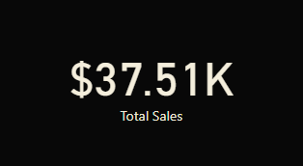
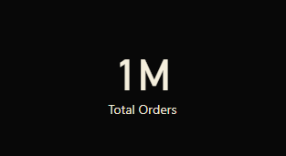

Key Performance Indicator

Slide 5
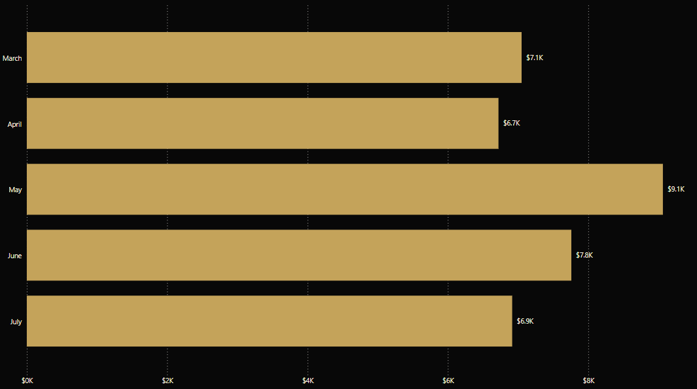
Sale Trends: Month over Month

Slide 6
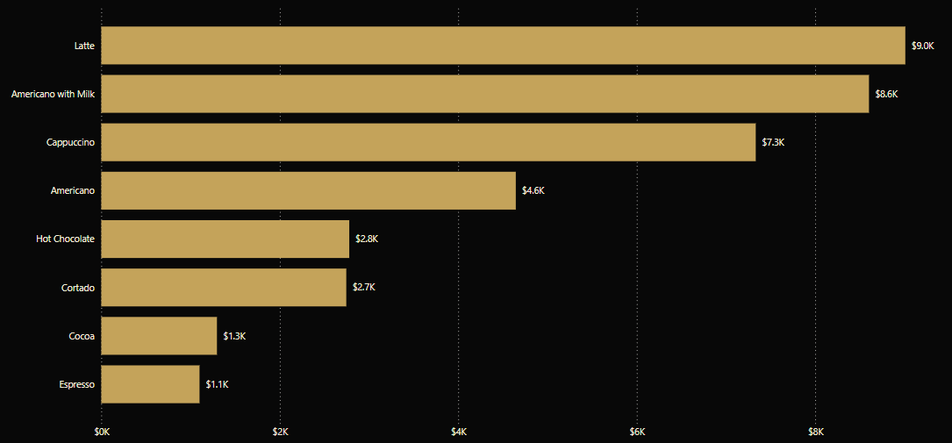
Top Selling Product

Slide 7
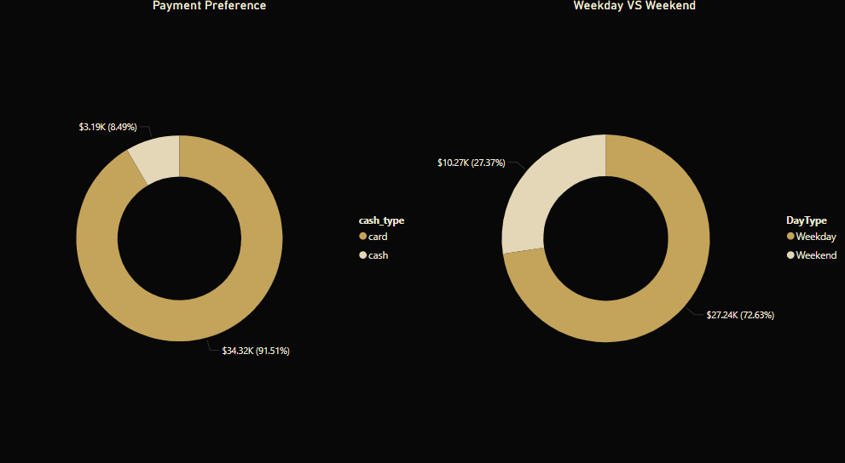
Customer Trends

Slide 8
Conclusion
The coffee shop sold over a million orders within 5 months! The Key Insights to note,
May has the highest number of sales.
Latte is the top selling product and Espresso, the least.
About 72% of sales happen in the weekdays. So having more staff and inventory on weekdays and less on weekends will be more efficient.
Customers also prefer card payments over cash. So streamlining card payments using latest technologies like NFC and giving exclusive rewards might boost overall sales and customer satisfaction.

